Slide 1



KYRA, ISAAC, PARKER
JAVA
KIP

Slide 2
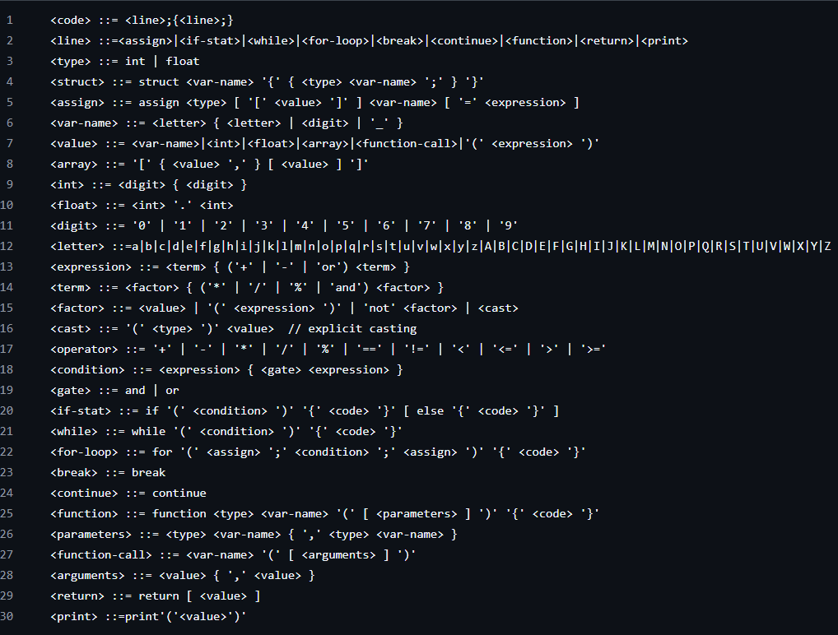
EBNF
GRAMMAR
keywords:
int
float
struct
assign
if
and
or
while
for
break
continue
function
return
print

Slide 3
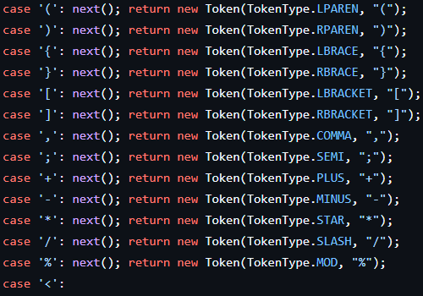
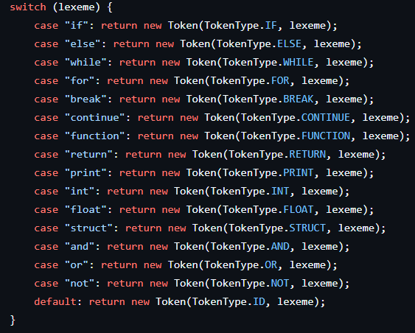
PROJECT
-creating the token list
-creating the arithemtic
-creating the brackets, etc
-creating semicolons, commas
LEXER

Slide 4
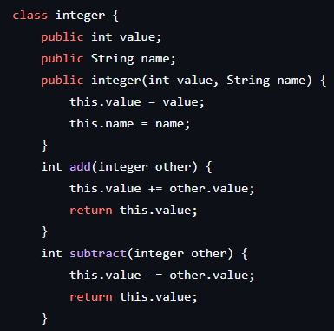

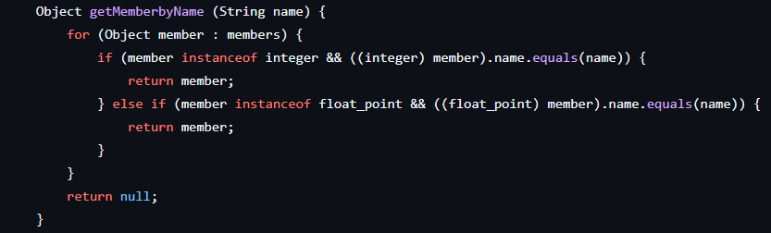
DATA
TYPES
Integer
Float Point
Structure
-methods for arithmetic
-allows for floats to be added to ints as well
-exclusively returns int values
-only exception is when converted to float
-methods for arithmetic
-exclusively has float returns
-can convert to ints
-creates objects
-determines what type they are

Slide 5
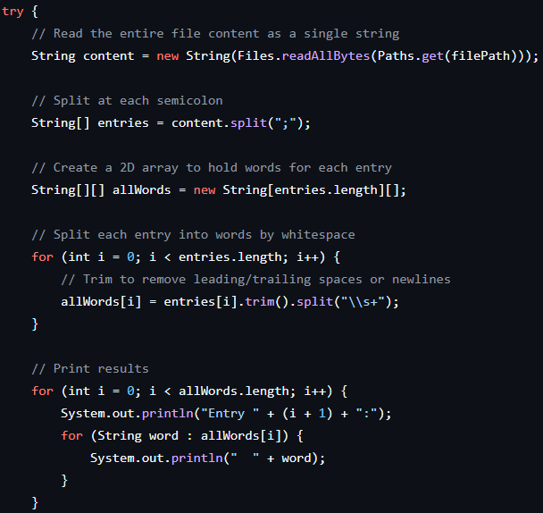
SPLIT
-input txt
-each line broken down by whitespace
-all words added to array
-array created for each line
TEXT

Slide 6
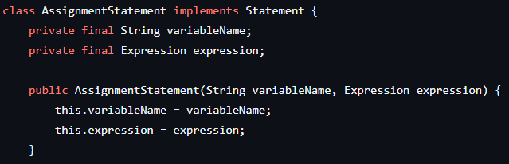
ASSIGNMENT
STATEMENTS
-creates a variable
-assigns it a name
-gives it a value

Slide 7
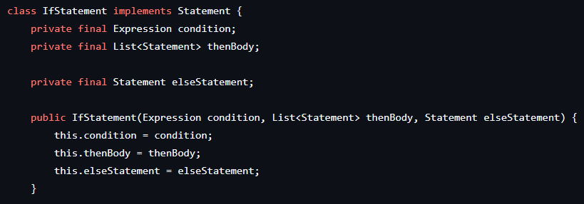
IF
STATEMENTS
-compare expressions
-execute code based on said statement
-run else if if statement is not valid

Slide 8
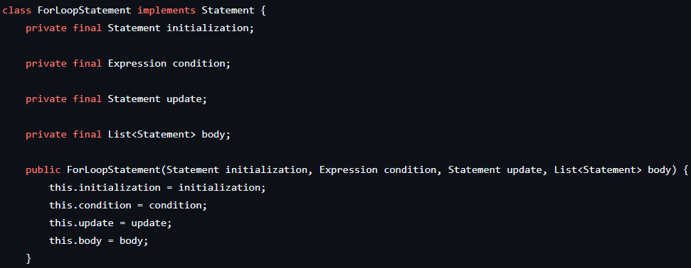
-creates a variable
-runs that variable in a condition
-updates said variable
-executes code
-variable can be used in code
-can also just be used for iterations
FOR
LOOPS

Slide 9
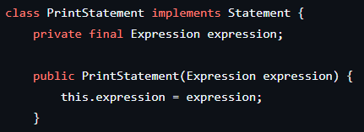
PRINT
STATEMENT
-displays info

Slide 10

PROJECT
GOALS
-create interpreter using java
-have a method written for each programming skill (assign, print, etc)
-each line of code in new language is a method call
-working with ANTLR
-plan to create AST to run with that program

Slide 11

PROJECT
LIMITATIONS
-every small task needs its own section of code
(like converting between ints and floats)
-very time consuming to code everything
-difficulty finding meeting times to work together

